Slide 1
IC Big
Imperial College Big Data Platform

Slide 2
Goals
Common platform for group to use
That improves our data analytics capabilities by providing ready to use libraries and solutions
Achieve coherence across our data
Provide a generic modelling engine
Base platform for IoT Data Inference Framework

Slide 3


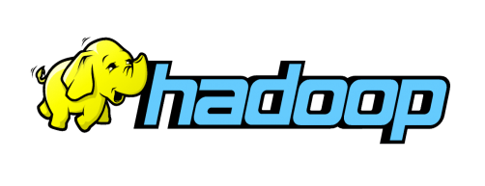


Hadoop
MR
Hive
TeZ
YARN

Slide 4

Spark
MR
Hive
TeZ
SQL
MLlib
GraphX
YARN

Slide 5
Spark vs Flink
Spark
Flink
JavaRDD<String> file = spark.textFile("hdfs://...");
JavaRDD<String> result = file
.flatMap(new myFlatMap());
public static class myFlatMap implements FlatMapFunction<String>
{
@Override
public void flatMap(String) {
…
}
}
DataSet<String> file = env.fromTextFile ("hdfs://...");
DataSet<String> result = file
.flatMap(new myFlatMap());
env.execute(“My Example");
public static class myFlatMap implements FlatMapFunction<String>
{
@Override
public void flatMap(String) {
…
}
}

Slide 6
Why Spark?
Spark and Flink (Stratosphere) are very similar
Apache now has two platforms performing the same task
Future of those platforms = ?
Now, Spark has more support:
MongoDB
Hbase, SQL
Mahout
Scala and R Bindings

Slide 7
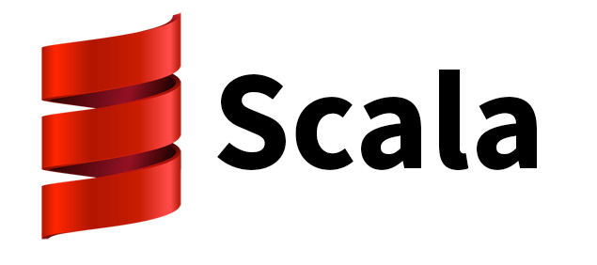


Spark supported Frameworks
SparkR
ML
DSL
DSL
MR
Hive
TeZ
SQL
MLlib
GraphX
YARN

Slide 8
Algebraic DSL
G=BB⊤−C−C⊤+sqs⊤qξ⊤ξ
val g = bt.t %*% bt - c - c.t + (s_q cross s_q) * (xi dot xi)
Notes:
Prototype, very limited

Slide 9

Jena
SparkR
ML
DSL
DSL
RDF API
ARQ
Ontology
Inference
MR
Hive
Jena
TeZ
SQL
MLlib
GraphX
YARN
TDB

Slide 10
Graph Database
IC
Hierarchical
Structural
Relational
Ontologies
DoC
WPL
User Y
Publication X
Room
214
Sensor Deployment
Human
Sensor
14
Notes:
Organizational dynamic, Sensor Metadata..etc

Slide 11
Data Ecosystem
Virtualization Layer (Data EcoSystem)
SparkR
ML
DSL
DSL
RDF API
ARQ
Ontology
Inference
MR
Hive
Jena
TeZ
SQL
MLlib
GraphX
YARN
TDB

Slide 12
Data Coherence
IC
DoC
User Y
WPL
Room
214
Sensor
Z
Sensor Readings
Sensor Readings
Sensor Readings
Sensor Readings
Other
Data in CSV
(HDFS)
Sensor Readings
(MongoDB)

Slide 13
Data Coherence
Browse (Jena):
Structure
Hierarchy
Relations
Ontologies
Query (Hadoop):
Time
Space
Layers

Slide 14
WikiSensing
WikiSensing
Plugin
Virtualization Layer (Data EcoSystem)
SparkR
ML
DSL
DSL
RDF API
ARQ
Ontology
Inference
MR
Hive
Jena
TeZ
SQL
MLlib
GraphX
YARN
TDB

Slide 15
WikiSensing Integration
Data Store through Virtualization Layer
Metadata and Ontologies
Registration of Function and Services
Access back to Gateways or Devices
Room
Y
Sensor
X
Sensor Readings
Meta
Data
Device
Function
172.17.70.15:7014/sensors?no=2&call=1

Slide 16
WikiSensing
WikiSensing
Plugin
Modelling Engine
Scheduler
Model Factory
Model Library
Virtualization Layer (Data EcoSystem)
SparkR
ML
DSL
DSL
RDF API
ARQ
Ontology
Inference
MR
Hive
Jena
TeZ
SQL
MLlib
GraphX
YARN
TDB

Slide 17
Modelling Engine
Model Library (e.g. Data Flow)
Store and Search for Generic Models
Model and Data Compatibility
Semantic Inference & Ontologies
Model Factory
Initiate a model with Data and Parameters
Scheduler
Execute Models

Slide 18
Algebraic DSL in Modelling
Model A
G=BB⊤−C−C⊤+sqs⊤qξ⊤ξ
Map
Function
val g = bt.t %*% bt - c - c.t + (s_q cross s_q) * (xi dot xi)
Notes:
Very Limited at the moment

Slide 19
AppEditor
WikiSensing
Concinnity
Concinnity Plugin
WikiSensing
Plugin
Modelling Engine
Scheduler
Model Factory
Model Library
Virtualization Layer (Data EcoSystem)
SparkR
ML
DSL
DSL
RDF API
ARQ
Ontology
Inference
MR
Hive
Jena
TeZ
SQL
MLlib
GraphX
YARN
TDB

Slide 20
Concinnity Integration
Connect sensors, analytics and models together in online workflows with the AppEditor
Integrate this ecosystem:
As Models
As Nodes in External Models
Connect with other models from the wider academic community (e.g. Agent Based Models of traffic flow)

Slide 21
AppEditor
Web API
WikiSensing
Concinnity
Concinnity Plugin
IoT Data Inference
Framework
WikiSensing
Plugin
Modelling Engine
Scheduler
Model Factory
Model Library
Virtualization Layer (Data EcoSystem)
SparkR
ML
DSL
DSL
RDF API
ARQ
Ontology
Inference
MR
Hive
Jena
TeZ
SQL
MLlib
GraphX
YARN
TDB

Slide 22
Information Inference Framework for Internet of Things
Is a interoperability framework for Internet of Things
which operates at information and data level instead of services and devices
exploits virtualization of IoT at the cloud and semantic inference
provides on demand information inference from data sources in a user`s surrounding or within a given environment
Notes:
The problem we are having, especially from these perspectives

Slide 23
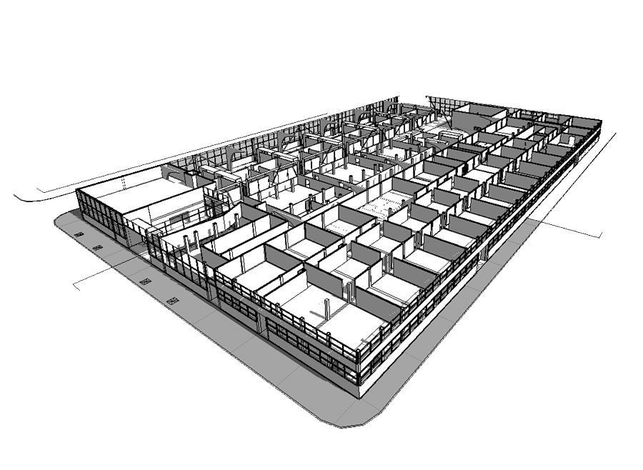
Virtualization

Slide 24
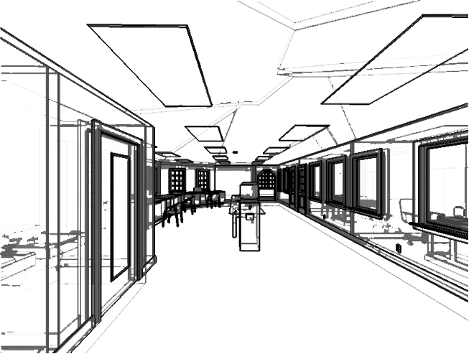
User

Slide 25
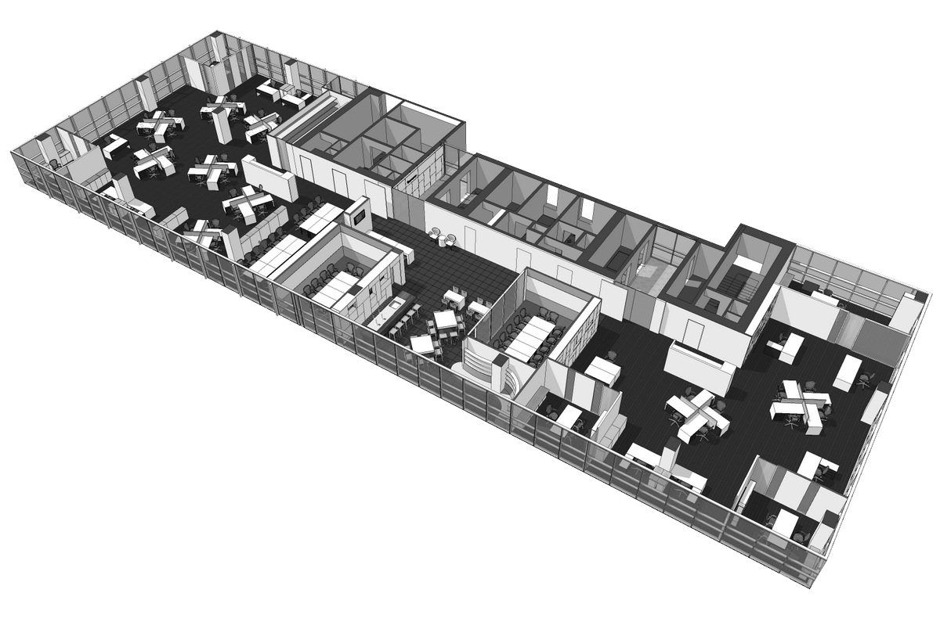
Environment

Slide 26
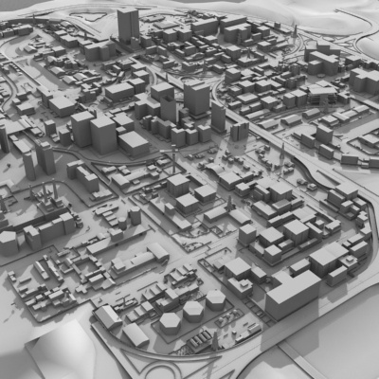
Environment
Notes:
Scope is Dataset not Environment

Slide 27
Conventional Approaches
Service Discovery and Matching
Interoperability at Middleware Level
Application entering a new environment searching for services and devices to use Eventually, Application has to show adaptivity to be able to use those services
Considering the number of different devices and configurations, this is not scalable
Notes:
The problem we are having, especially from these perspectives

Slide 28
New Approach
Application part that is Subject to Mobility and Dynamicity is removed
and implemented as a generic reusable model
Application
Part that uses services or sensors
Notes:
On Cloud

Slide 29
On Demand Information
Application will request that information or data (semantically expressing it)
It will be built on demand
Application
Temperature of Room X?
Model A
Model B
Model C
Notes:
Temperature has URI, so does room and that specific room, and ontologies

Slide 30
Design
Object Oriented -> Inheritance
Data Oriented -> Semantic Inference
Constraint Satisfaction Problem
Backjumping Algorithm

Slide 31
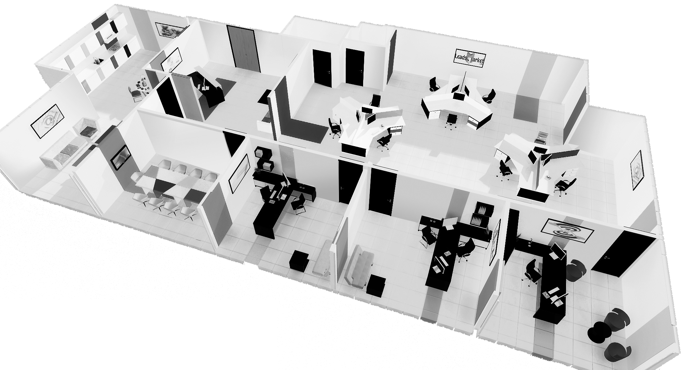
User Example

Slide 32
User Example
HVAC System
Temp Sensor
Common Area
Kitchen
Lobby
Temp Sensor
of Fire detector
Smart Phones
CR
Room 1
Room 2
Room 3
Room 4
Temp Sensor
of Screen
Temperature Sensors

Slide 33
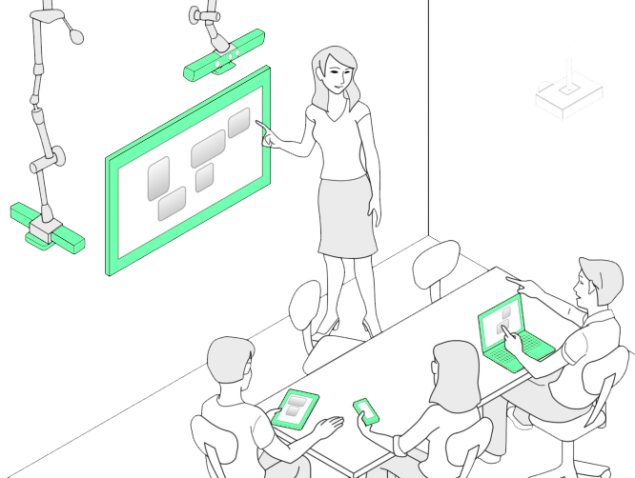
Environment Example

Slide 34
Environment Example
Room X
Body Sensor
User D
Smart Screen
Model
Z
Other
User
Data
Tablet
Screen Sensor 1
User C
Model
Y
Body Sensor
Smart Glass
User B
Smart Watch
User A
Smart Phone
Notes:
Heartbeat

Slide 35
AppEditor
Web API
WikiSensing
Concinnity
Concinnity Plugin
IoT Data Inference
Framework
WikiSensing
Plugin
Modelling Engine
Scheduler
Model Factory
Model Library
Virtualization Layer (Data EcoSystem)
SparkR
ML
DSL
DSL
RDF API
ARQ
Ontology
Inference
MR
Hive
Jena
TeZ
SQL
MLlib
GraphX
YARN
TDB

Slide 36
Workplan
Platform (6 months)
Hadoop + Jena + Spark Deployment – 1 month
Data Ecosystem + Modelling – 3 months
WikiSensing Integration – 1 month
Concinnity Integration – 1 month
Data Inference Framework (4 months)
Design - 1 month
Implementation – 3months
DCE Smart Lab Deployment (3 months)
Deployment - 1 month
Testing and Evaluation of the Framework – 2 months

Slide 37
AppEditor
Web API
WikiSensing
Concinnity
Concinnity Plugin
IoT Data Inference
Framework
WikiSensing
Plugin
Modelling Engine
Scheduler
Model Factory
Model Library
Virtualization Layer (Data EcoSystem)
SparkR
ML
DSL
DSL
RDF API
ARQ
Ontology
Inference
MR
Hive
Jena
TeZ
SQL
MLlib
GraphX
YARN
TDB

Slide 38
Problems
Hardware:
CSG Cloudstack
Transfer to DSI when DSI machines arrive

